Slide 1
RVMS
A practical reactive architecture for Flutter
Thomas Burkhart
@thomasburkhartb

Slide 2
Why another architecture?
Most existing architectures like MVP/MVVM don‘t match the reactive View updating of Flutter.
All current State Management solutions address only a small aspect but don’t give guidance on the architecture of the whole App.
MVU describes Flutter quite well but is only an abstract concept.

Slide 3
Goals of R(x)VMS
Easy to explore and to understand
No configuration by convention (violates 1)
Avoiding black magic of a framework (violates 1)
Encourage the feeling of work ownership when working on a team
Clear separation of concerns
Easy to test
Able to scale
Minimal boring boilerplate code
Not too rigid to be flexible
Fun to work with
Highly Reactive
Notes:
5 let the Widgets rule not some central state machine

Slide 4
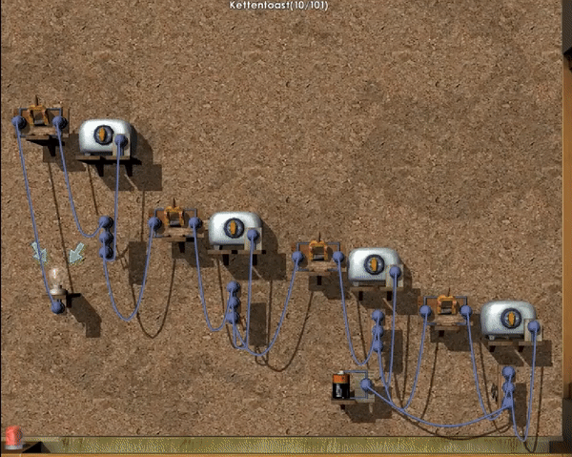

Slide 5
Structure of a RVMS App
ViewS
Domain Objects
AggregatorsAdapters
ManagerS
ServiceS

Slide 6
Services
Encapsulate functionality beyond the Apps boundaries like:
REST APIs
Databases
OS Services like Contacts / Calendar
Hardware features like Location, acceleration sensors
Convert data from / to the external data format (e.g. JSON) to domain objects
Don’t change any App State on their own
Each Service should only wrap one external aspect.

Slide 7
Managers
Wrap semantically related business logic e.g.
User Management/Authentication
Notification Management
Invoices
No direct mapping to a specific View (Managers ≠ ViewModel)
Often provide CRUD functionality for domain objects
Implement any (business) logic that change App State
Therefore use Services / other Managers
Provide Commands/ValueListanebles for the UI
Are accessed by ServiceLocator or DI.

Slide 8
Views
Full Page or Custom View
Are self responsible
Select which data they need from Managers or directly from Services (read-only) typically by listening on ValueListenables or Streams
Modify data by using Commands in Managers or call functions in managers.
Don’t modify data / state by using Services
Don’t change any state that isn’t related to the task the View is made for, that is the duty of business logic inside Managers

Slide 9
Domain Objects
Objects that represent real world objects or abstract concepts from the application domain such as: users, invoices, tickets
If they have methods, they ONLY change their own internal state, never any other objects
Often provide factory functions like to/from JSON that Services can use.
Aggregators
Wrap multiple Domain Objects so that they can be passed over a ValueLIstenable as one entity. This can be Lists, Tuples or custom Objects
Adapters
If data conversion from the type of a Domain Object is too complex to be used by a View, the Domain Object can be wrapped inside a Adapter that encapsulates the conversion
Rarely needed in Flutter 😉

Slide 10
Interactions inside an RVMS App
Invoice Detail View
Invoice Manager
Database Service
Login View
**
Authentication Service
User Manager
Map View
Location Service
ValueListenables
(async) function calls
or Streams
** Can be (async) function calls or ValueListenables or Commands. But should be limited as much as possible to avoid unnecessary coupling.
Comands
or
method calls

Slide 11
Building blocks: Commands
Wraps a sync/async function that is executed by calling .execute(value)
Is an ValueNotifier<TResult> itself
Is a callable class, so you can assign it directly: onTextChanged: myManager.onSearchChangedCommand,
Command<TParam,TResult>
.execute(TParam)
TResult
restrictions true / false
results CommandResult<TResult>
canExecute true / false
isExecuting true / false
thrownExceptions: Exception
ValueNotifier<type>
Notes:
If you love Streams there is also a package called rx_command

Slide 12
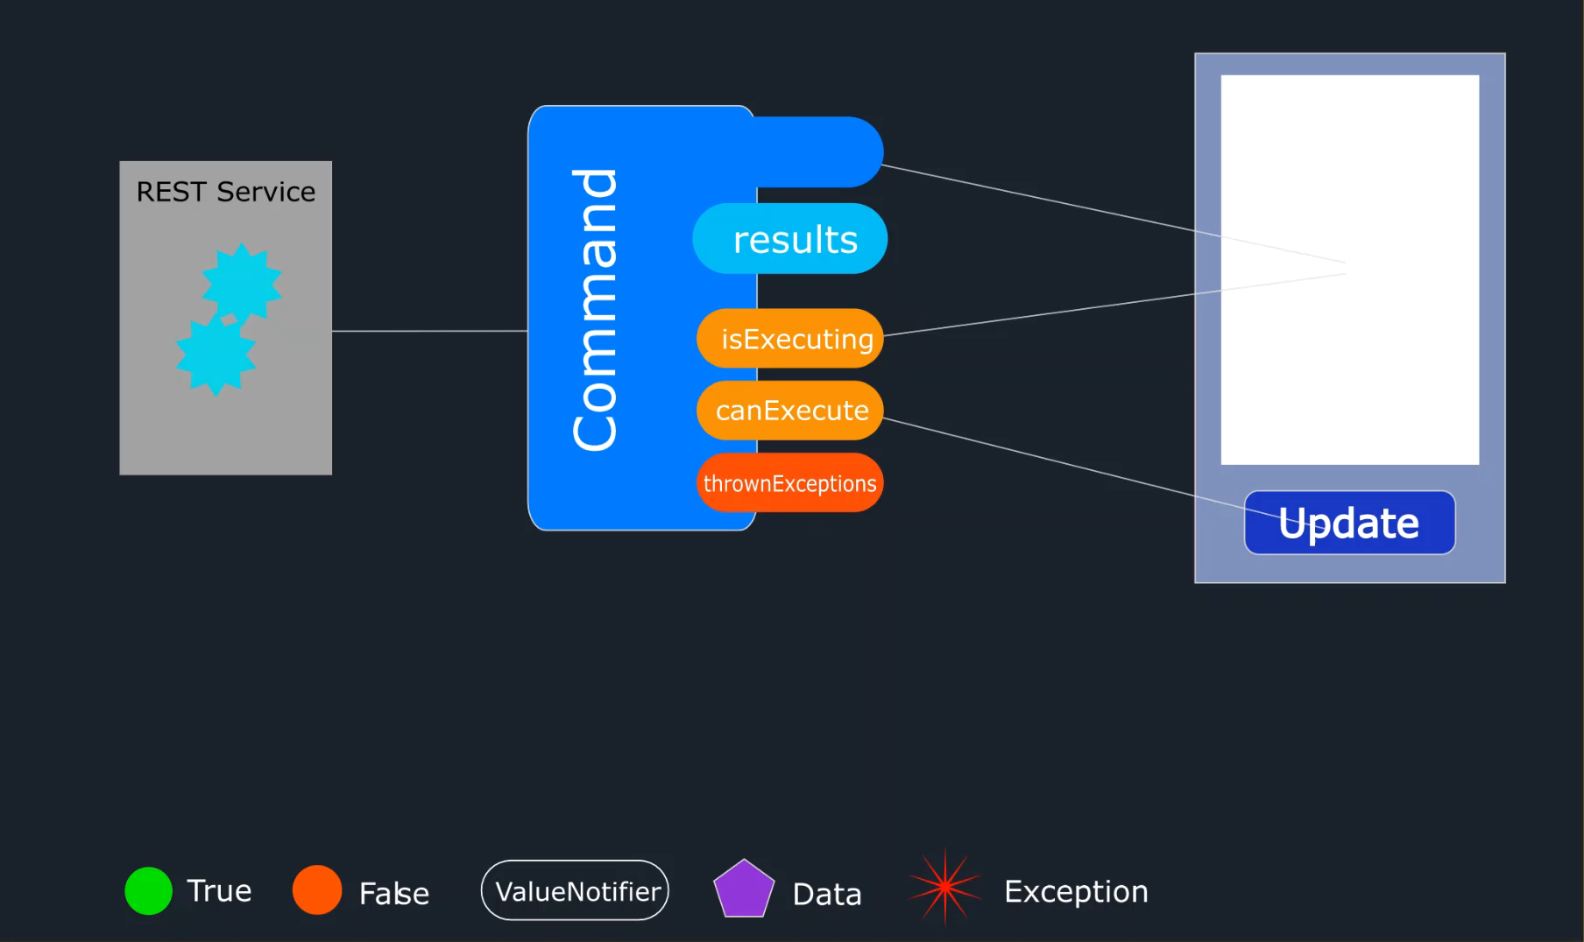
A command in motion

Slide 13
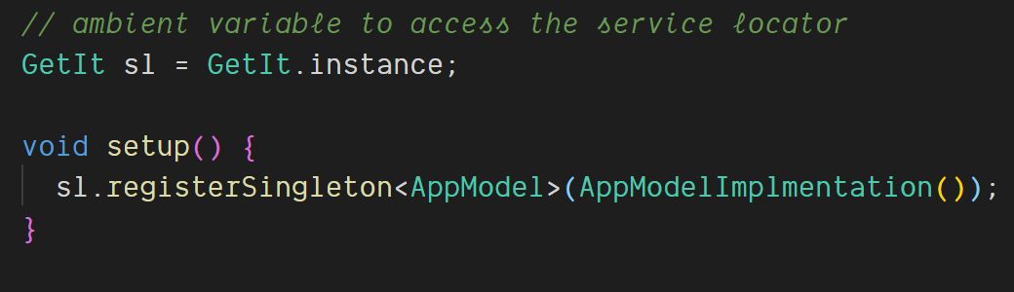
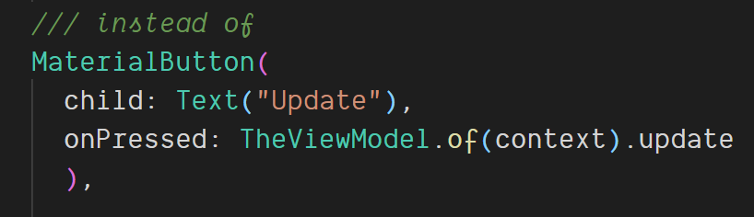
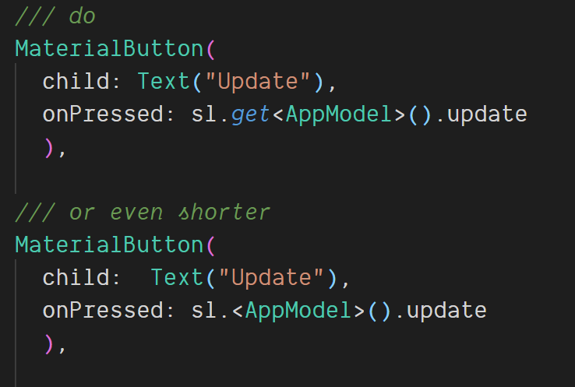
Building blocks: ServiceLocator GetIt
Notes:
Allows the access to registered objects from anywhere in the App
Objects can be registered with their super type so that the concrete implementation can be exchanged any time.

Slide 14
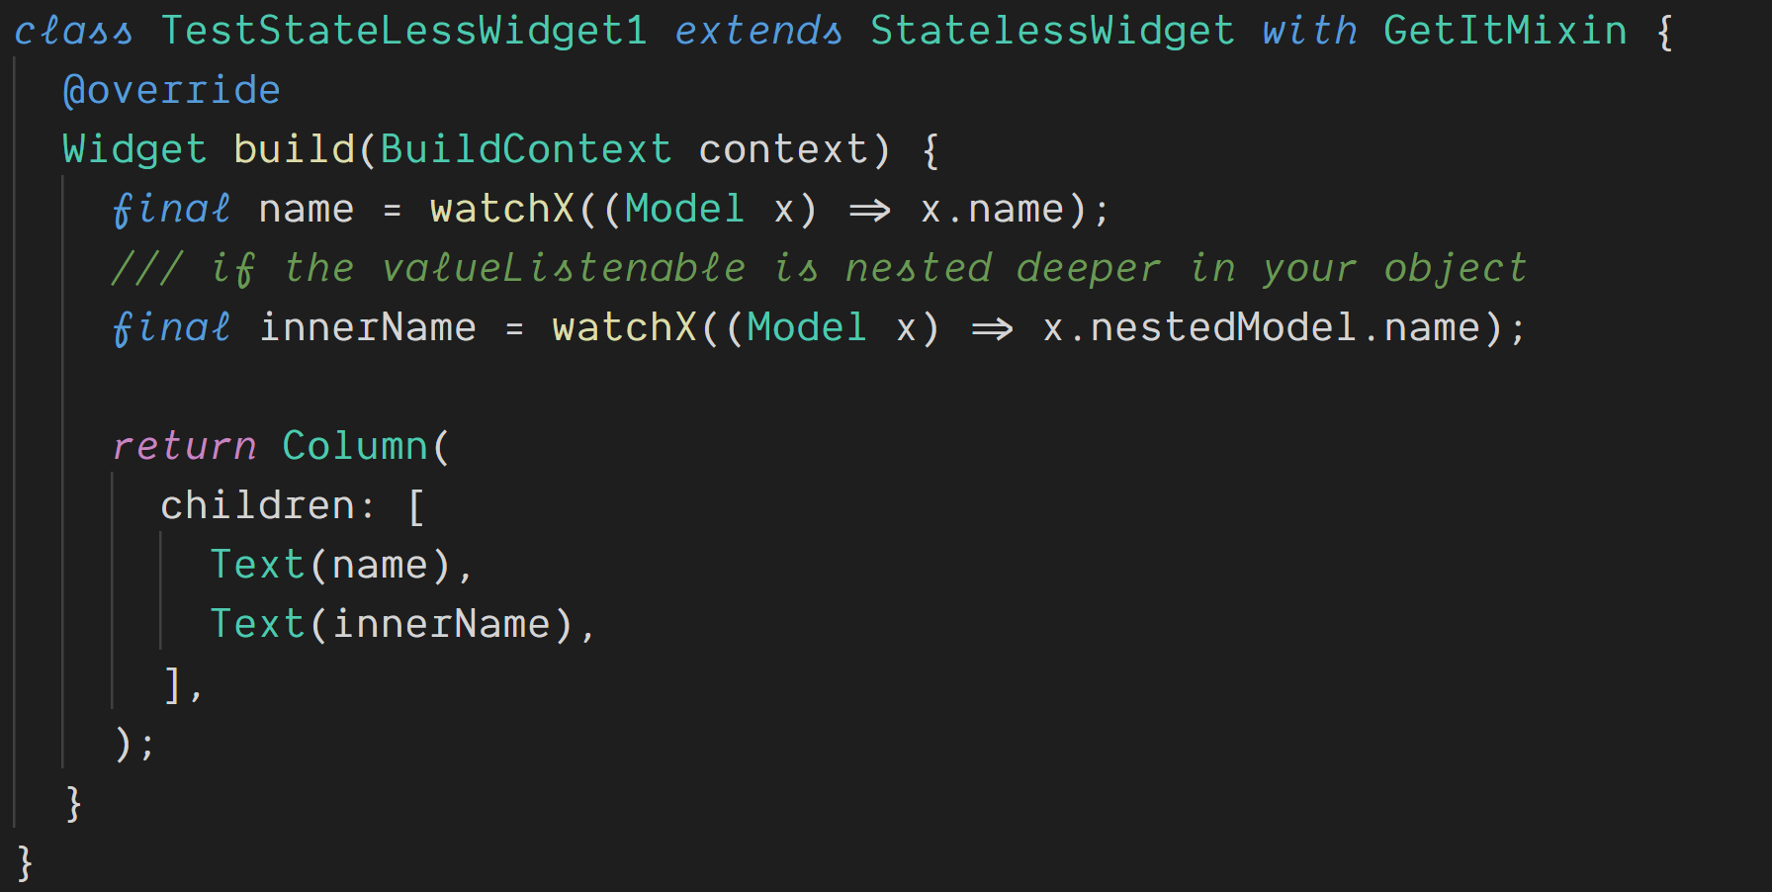
Everything gets easier with GetMixin
Notes:
Allows the access to registered objects from anywhere in the App
Objects can be registered with their super type so that the concrete implementation can be exchanged any time.

Slide 15
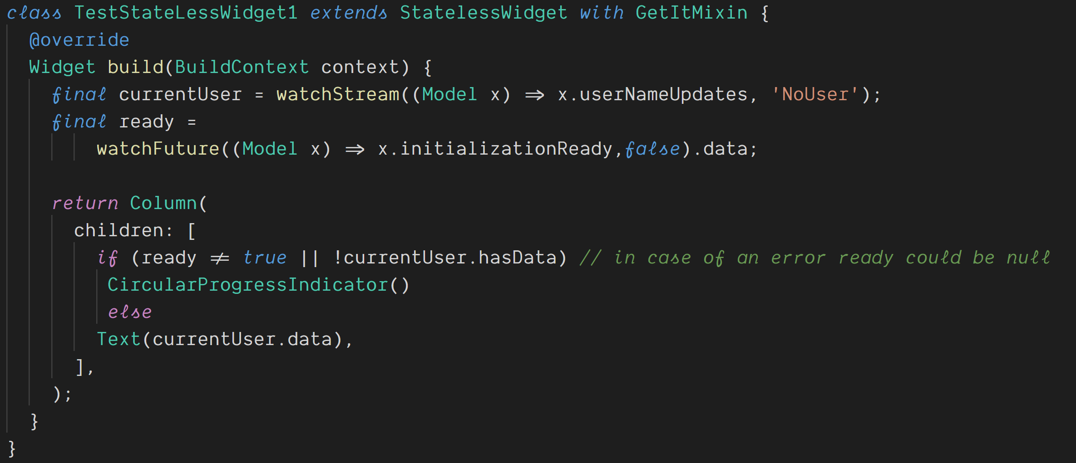
Everything gets easier with GetMixin
Notes:
Allows the access to registered objects from anywhere in the App
Objects can be registered with their super type so that the concrete implementation can be exchanged any time.

Slide 16
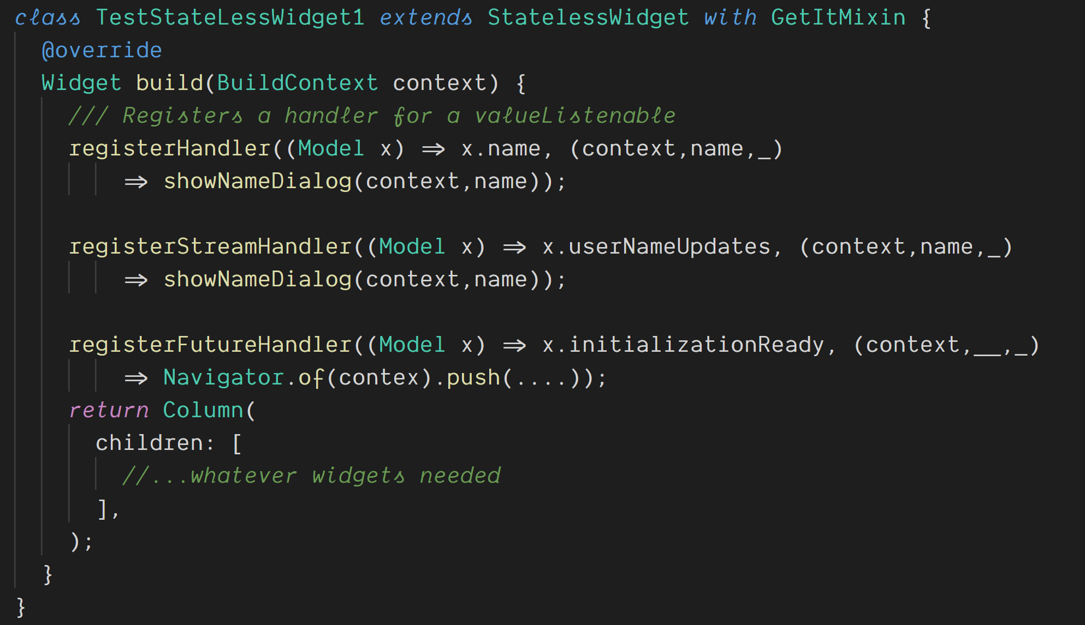
Everything gets easier with GetMixin
Notes:
Allows the access to registered objects from anywhere in the App
Objects can be registered with their super type so that the concrete implementation can be exchanged any time.

Slide 17
Let‘s see some code

Slide 18
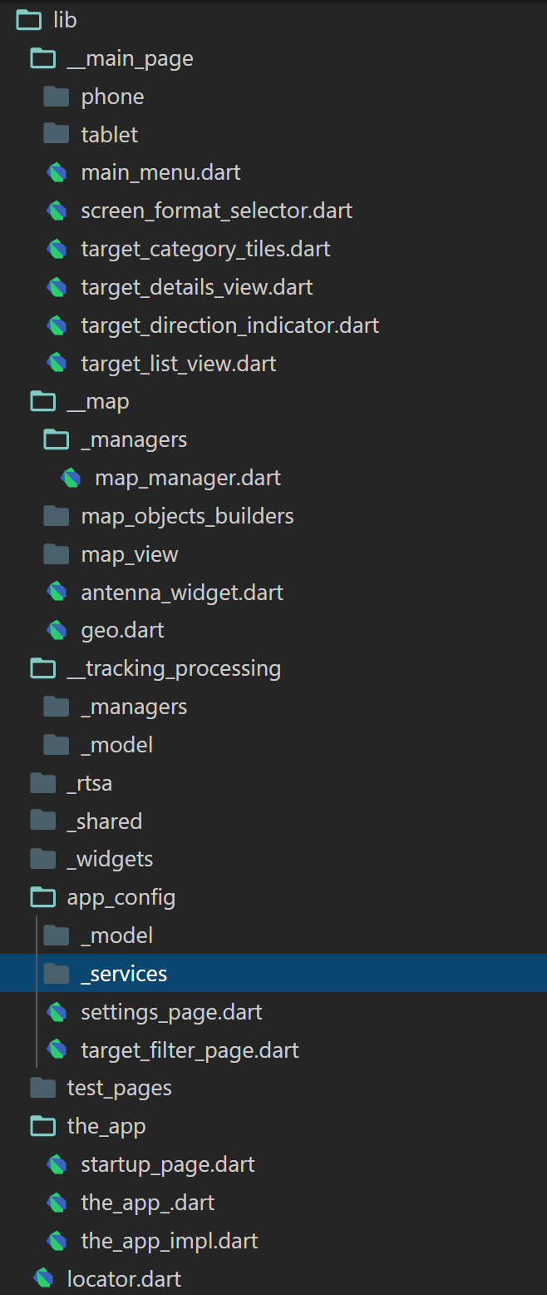
Project structure
main folders are organized by features / bigger function blocks
A feature folder contains all pages, widgets, manager, models and services that are needed by the feature
widgets contain all Widgets that are used on more than one page
locator.dart contains the global instance of the ServiceLocator and all object registrations.

Slide 19
The self responsible Widget
Each widget either gets its needed data passed in the constructor or ‘organizes’ it on their own behalf
decides to which data updates it subscribes or which data it wants to pull
only uses Managers/ Services if data outside its own state has to be used / modified
may read data directly from Services
may read/update data via Managers
don’t implement business logic beyond their semantic context
therefore its logic is easy to understand, to test or debug
Encourages feeling of ownership because you implement all the needed functionality for a Widget/Page
Notes:
3. Example a Page that edits user profiles should not call a function in the InvoiceManage if there is a business necessity to interact then the UserManager should deal with that

Slide 20
Resources
My blog: https://www.burkharts.net/apps/blog/
You can find me on Twitter @ThomasBurkhartsB
And on most chats under ‚escamoteur‘
You can find a full app example here https://github.com/escamoteur/flutter_architecture_samples/tree/rvms
https://pub.dev/packages/get_it
https://pub.dev/packages/get_it_mixin
https://pub.dev/packages/flutter_command
This presentation and the example project can be found here: https://github.com/escamoteur/RVMS-2020

Slide 21
Questions?

